Slide 1
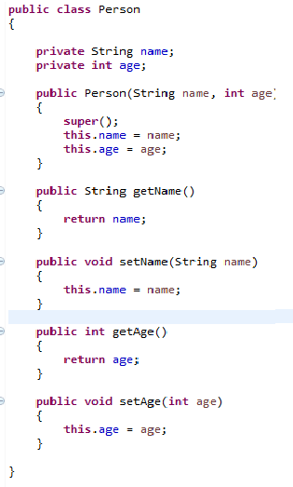
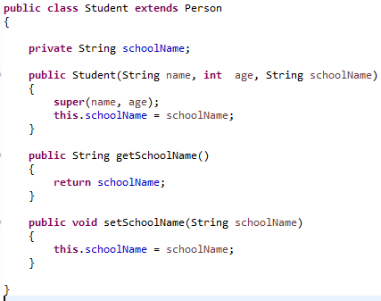
Invoke a Superclass constructor with parameter
Using super(parameter list), the superclass constructor with a matching parameter we can call.

